Slide 1
MTN-027 Enrollment Visit Procedures
Phase 1 Safety and Pharmacokinetics Study of MK-2048/Vicriviroc (MK-4176)/MK-2048A Intravaginal Rings
MTN-027 Study Specific Training

Slide 2
References
Protocol Section 7.3 (Enrollment)
SSP Section 4: Study Procedures
SSP Section 6: Web Randomization
SSP Section 7: Study Product Considerations for Non-Pharmacy Staff
Section 9: Laboratory Considerations
Section 10: Counseling Considerations
Section 11: Behavioral Measures
Section 12: Data Collection

Slide 3
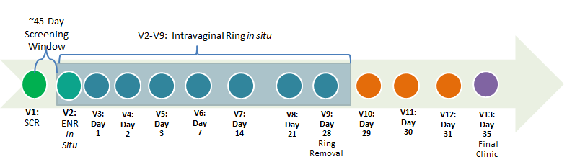
Enrollment Visit Considerations
Schedule within 45 days of screening
Enrollment Visit should not be split
Plan for a full day in the clinic (7-8 hours)
Menses must not coincide with a participants enrollment visit (Visit 2/Day 0), or with study visits 3-6 (Days 1, 2, 3, and 7).
Menses
Notes:
If a participant is menstruating on the day of enrollment, her entire visit should be rescheduled for after the completion of menses.
If the participant is enrolled and subsequently starts her menses during days 1-7, the pelvic exam and sample collection should continue as long as the participant is comfortable, but the management team should be notified (see also SSP section 8.7).

Slide 4
Enrollment Visit - Overview
Final confirmation of eligibility and documentation of baseline conditions
Randomization and Study Product Dispensation
Vaginal Ring Insertion and Post-insertion serial PK collections
Review informed consent and confirm participant is still interested in continued study participation

Slide 5
Before randomization:
Administrative:
Check Screening Window
Review/confirm Locator
Review/confirm IC
Confirm Eligibility
Clinical:
Medical/Menstrual Hx
Concomitant Meds
Physical Exam
Pelvic Exam
Document Pre-Existing
Provide Test Results
Treatment or referral*
Laboratory:
Urine:
Pregnancy (hCG)
Dispstick UA*
Urine culture*
Pelvic Exam:
Cytobrush
Vaginal pH
Gram stain
Swab – biomarkers
Quant. vaginal culture
Trichomonas*
Wet mount for candidiasis or BV*
GC/CT*
Rectal Fluid (optional)
Counseling:
HIV pre-/ post-test
HIV/STI risk reduction
Contraceptive
Protocol/Product (can also be done after randomization)
Behavioral Assessment:
  Baseline CASI
Laboratory:
Blood:
HIV Serology
CBC with diff/platelets
Serum Chemistries
Plasma Archive
Syphilis Serology*
* If indicated

Slide 6
Enrollment Counseling Considerations
HIV pre/post test counseling and HIV risk reduction counseling should be done in conjunction with HIV testing at enrollment
Contraceptive Counseling should be provided in the context of the study eligibility criteria related to pregnancy intentions and willingness to use an effective contraceptive method
  Protocol/Product Adherence Counseling can be done before or after randomization
Notes:
Documentation (Already reviewed during Screening):
-HIV Counseling Worksheet
-Contraceptive Counseling Worksheet
-Protocol/Product Adherence Counseling Worksheet – Details to be review later in presentation

Slide 7
Baseline CASI
Demographic information
Motivation to join the trial
Vaginal and Menstrual practices
Pregnancy history and contraception use
Sexual behavior and substance use
Product acceptability, Vaginal ring concerns
Each participant will complete a Baseline Questionnaire by CASI at the Enrollment Visit prior to randomization.
In-depth CASI training scheduled separately

Slide 8
Eligibility Confirmation
Notes:
Each study site must establish a standard operating procedure that describes how study staff will fulfill this responsibility of confirming eligibility. This SOP minimally should contain the following elements:
Eligibility determination procedures, including:
During-visit eligibility assessment procedures
Post-screening visit eligibility assessment and confirmation procedures (i.e. review of laboratory results)
Final confirmation and sign-off procedures prior to enrollment/randomization
Documentation of each eligibility criteria (met or not met)
Ethical and human subjects considerations
Staff responsibilities for all of the above (direct and supervisory)
QC/QA procedures (if not specified elsewhere)

Slide 9
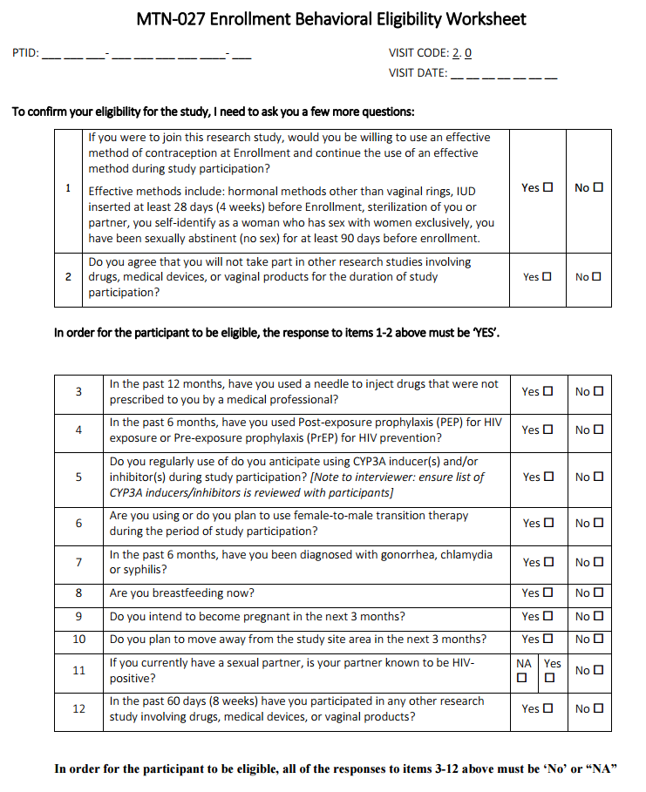
EnrollmentBehavioral Eligibility Worksheet
Recommended source document for assessing eligibility criteria which are based on self-report

Slide 10
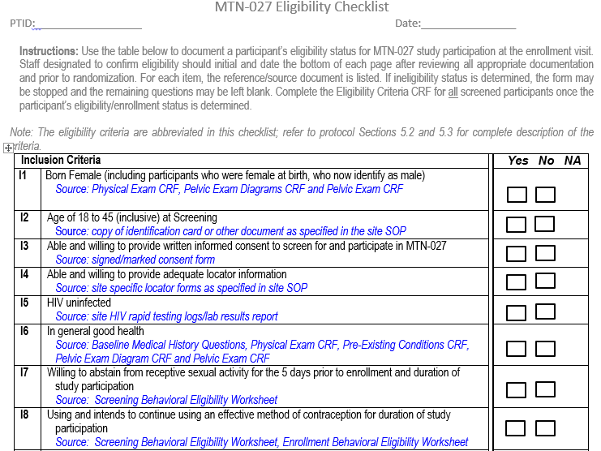
Eligibility Checklist
Documents final participant eligibility for all inclusion/exclusion criteria
To be completed on day of enrollment by designated staff.
Initial and date at bottom of each page.
Recommended source document for each item is listed in italics for ease of reference

Slide 11
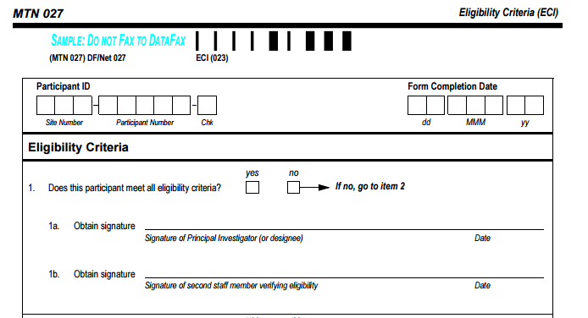
Eligibility Confirmation - Signatures
Once eligibility status is confirmed by reviewing and completing the Eligibility Checklist, document the participant’s eligibility status on the Eligibility Criteria CRF.
Note: The IoR or designee should complete item 1a and a second staff verifying eligibility must complete item 1b.
Notes:
Put this in for flow – can mention this form will be reviewed in detail by SCHARP later in the presentation.

Slide 12

Randomization/Study Product Dispensation
FSTRF web randomization system will be used for MTN-027 (training already completed)
Randomization is the act of enrollment into MTN-027.
  Notify the MTN-027 Management Team and PSRT if ineligible participant has inadvertently been enrolled in the study
Study Product Dispensation Documentation (Prescription, Accountability Logs), and Chain of Custody Procedures will be covered during Study Product Considerations section of the agenda – stay tuned!

Slide 13
After randomization
Administrative:
Reimbursement
Schedule Next Visit
Clinical:
Exam to check placement of the IVR
Counseling:
Protocol/Product (if not done prior to randomization)
Laboratory:
Vaginal PK (self-swab) at hour 0 (before ring insertion)
PK blood collection at hours 1,2,4,6 post-ring insertion
Vaginal PK (self swab) at hours 1,2,4,6 post-ring insertion
Study Product:
IVR Use Instructions
Receive/Insert IVR

Slide 14
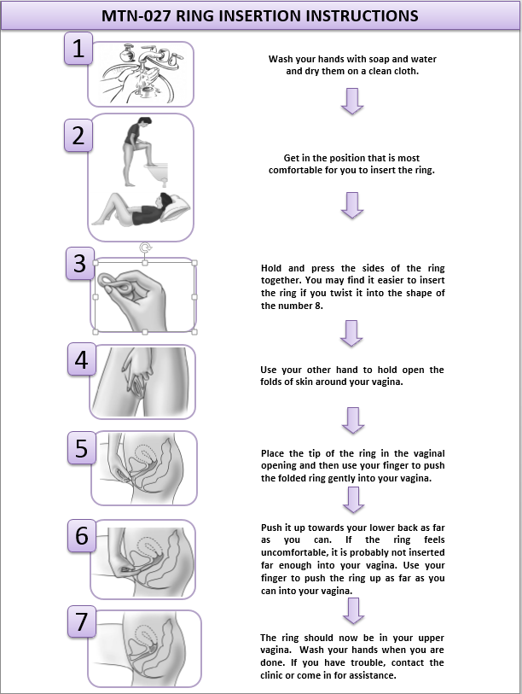
IVR Insertion Instructions
Actively review these instructions with participants, and use visual aids and pelvic models (if available) to help explain ring insertion and removal.
A copy of the illustrated instructions should be offered to each participant.

Slide 15
Ring Insertion
REMINDER: collect ‘hour 0’ vaginal PK swab prior to ring insertion
Difficulties inserting the IVR are expected to be rare.
Perform in a private space, with staff standing by in case the participant requests guidance or technical assistance.
It is recommended that staff also confirm that the participant is able to remove and reinsert the VR.
  This is to encourage comfort with removal procedures, and additional practice in case the VR is removed or accidentally falls out prior to her next clinic visit.
Notes:
For participants who have difficulty or who have inserted the ring incorrectly, study staff should provide further information and guidance to address the difficulty encountered. After guidance is provided, the participant should try again to insert the vaginal ring at the enrollment visit. If she is unable, study staff may insert the ring for the participant.

Slide 16
Ring Removal Instructions
Before removing the ring, wash and dry your hands.
Choose a comfortable position (can reference ring insertion instructions for illustrations of different positions).
Put a finger into your vagina and hook it through the ring.
Gently pull down and forward to remove the ring.
If you will be reinserting the ring, follow the ring insertion instructions, and wash your hands when you are done. If you will not be reinserting the ring, continue to steps 6-9 and contact the study clinic.
Place the used ring in the bag provided by clinic staff or other suitable container if the bag is not available.
Wash your hands.
Place used ring and container in a safe and private area out of reach of children or other occupants of the home.
Bring any used ring (in its container) with you to the clinic during your next study visit.
Notes:
To be provided verbally to participant (no printed materials available)
For presenting during training, will not read all the items listed here, but briefly mention that we have these instructions, where they are located, and why we are not providing written instructions to participants

Slide 17
Exam to Check Ring Placement
After ring placement, the participant should walk around prior to verification of correct ring placement.
The participant should then lie comfortably on the examination couch in supine position (on her back).
Upon genital inspection, the ring must not be visible on the external genitalia. If the ring is visible, the placement is not correct.
The ring should not press on the urethra.
On digital examination, the ring must be placed at least 2cm above the introitus beyond the Levator Ani muscle.
If, on inspection, the ring is found to be inserted incorrectly, the ring should be removed and reinserted correctly by the participant or the study clinician.
Notes:
At the Enrollment Visit, study staff are required to confirm proper placement of the VR by a digital examination (see Section 10.2.2.1). For all other follow-up visits, this procedure should be done only if indicated (i.e. the participant is having discomfort potentially due to improper VR placement).

Slide 18
Study Product/Protocol Adherence Counseling
Important that adherence be addressed using a neutral approach, so as to leave the participant feeling comfortable/free with discussing instances of non-adherence.
Participants should be encouraged to ask questions and raise issues or problems at any time.
Participants should be encouraged to pay attention to their ring use experiences during the study, and to share these experiences with staff.

Slide 19
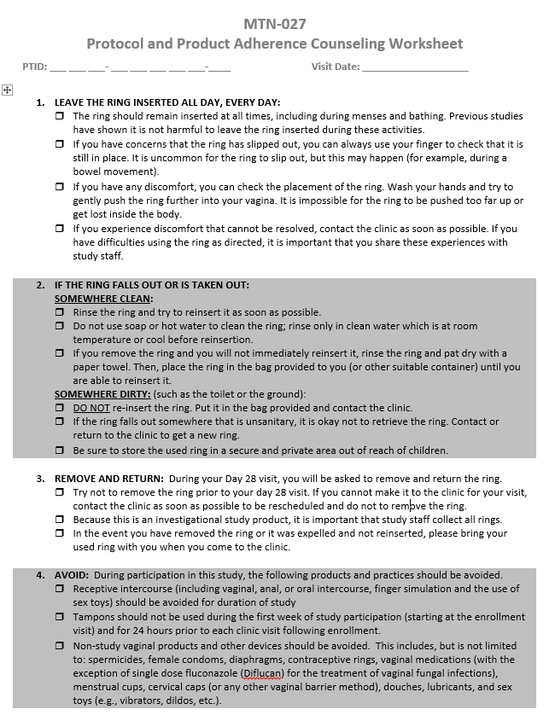
Protocol and Product Adherence Counseling Worksheet (1)
Overview of the minimum requirements for protocol adherence counseling sessions
Review of how to use the ring, what do if the ring comes out, and the prohibited medications, products and practices during study participation.
Mark each item reviewed with participant

Slide 20
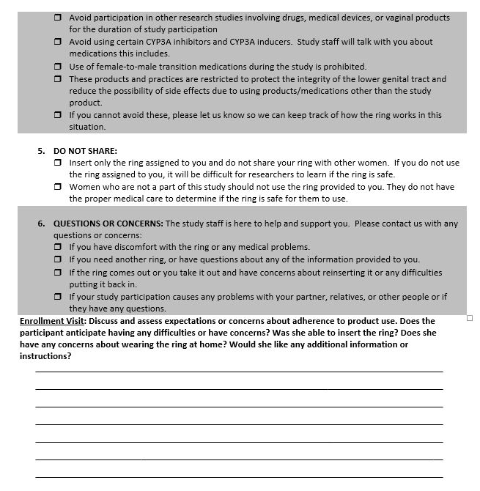
Protocol and Product Adherence Counseling Worksheet (2)
Counseling Notes:
Does the participant anticipate having any difficulties or have concerns?
Was she able to insert the ring?
Does she have any concerns about wearing the ring at home?
Would she like any additional information or instructions?

Slide 21
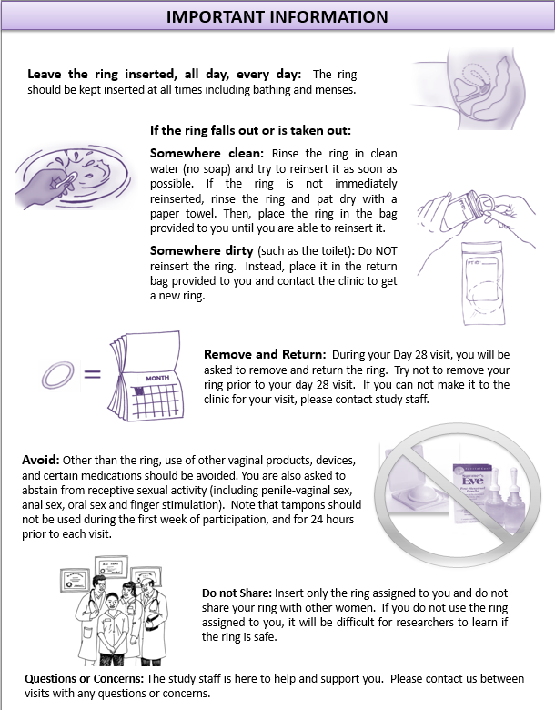
Protocol/Product Adherence: Important Information Sheet
Summarizes key counseling messages in a format that is available for participant to take home.

Slide 22
Serial PK Collections
After ring insertion, serial collection of Blood and Vaginal Swab will occur at hours 1, 2, 4, and 6
Detailed guidance regarding these procedures will be covered during the Laboratory Considerations section of the training.

Slide 23

MTN-027
Enrollment Visit
CRFs

Slide 24
Enrollment CRFs
Enrollment CRF
Physical Exam CRF
Pelvic Exam CRF (pelvic exam diagrams form)
Specimen Storage CRF
Pharmacokinetics – Enrollment CRF
Safety Laboratory Results CRF
Notes:
Note that SS, PE, PX, SS, PK, SLR will be covered during the review of the clinical and lab CRFs

Slide 25
PRE CRF at Enrollment Visit
Severity Grade
If condition has resolved since screening, do not modify severity grade recorded at screening visit
  Just mark “no” for ongoing at Enrollment
For ongoing condition, update severity grade as needed; that is, if severity has changed since screening (higher or lower severity)
  Ex. Grade 2 earache originally reported at screening that improves to Grade 1 at enrollment visit

Slide 26
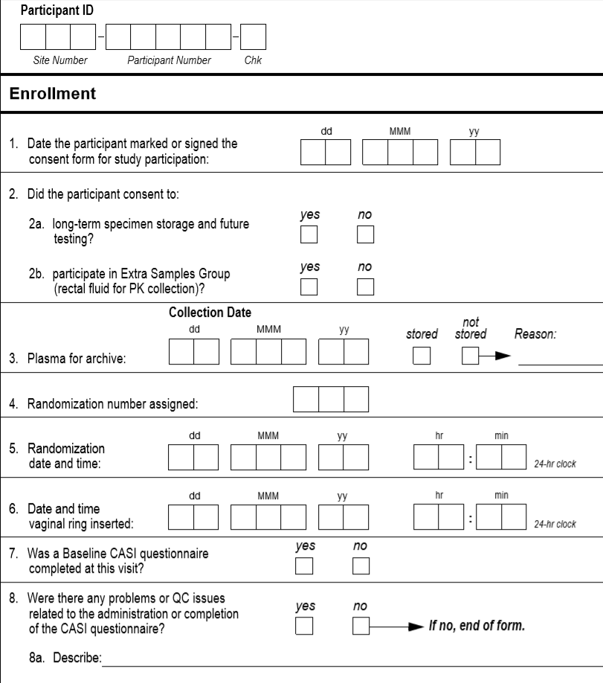
Enrollment (ENR-1)
Enrollment CRF documents:
Consent
Plasma for archive
Randomization
IVR insertion
Baseline CASI

Slide 27
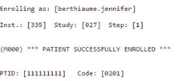
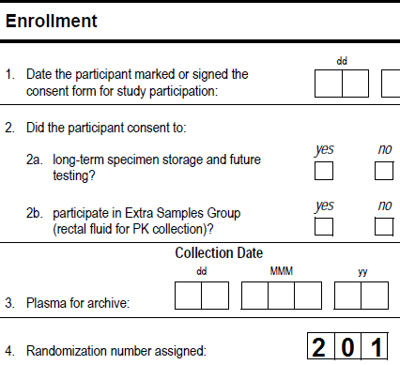
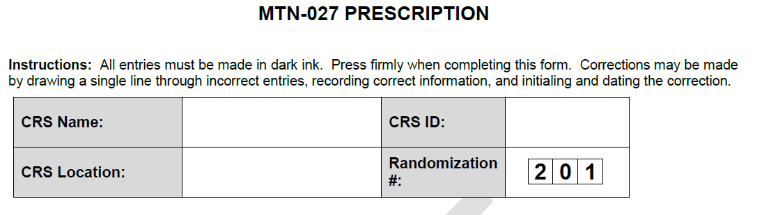


Enrollment (ENR), item 4

Slide 28
Enrollment Visit QA/QC
During visit:
  Make sure eligibility is confirmed per SOP prior to randomization
    Review visit checklist to make sure all required procedures completed
    Plasma archive collection, administration of Baseline CASI Questionnaire, physical exam and pelvic exam are required prior to randomization
If Randomized/Enrolled
  Fax all appropriate Screening and Enrollment CRFs to SCHARP
  File copy of FSTRF randomization notice email in participant binder

Slide 29

Questions??

